Slide 1

GPIO Analog Input for Digital Temperature Sensor
Yao-Tung Tsou

Slide 2
Digital Temperature Sensor
Here is a straight forward, yet effective digital temperature controller that can be used with temperature control systems.
The circuit uses IC LM 35 to as the temperature sensor.
The output of LM 35 is given to the IC ADC 0804 which converts the analog output of the LM 35 to digital output.
The ADC 0804 is a 8 bit ADC

Slide 3
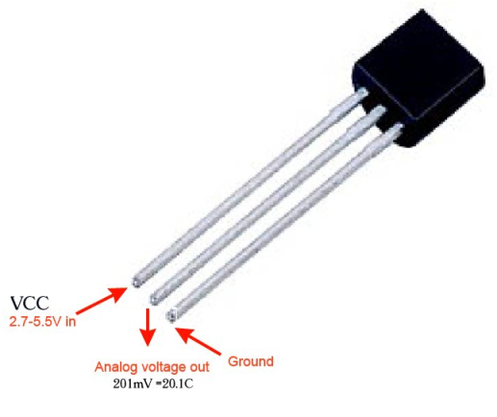
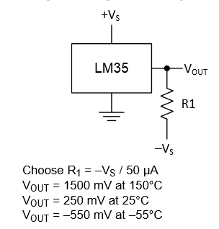
LM35
Wide range, low power temperature sensor outputs an analog voltage that is proportional to the ambient temperature.
To use, connect pin 1 (left) to power (between 2.7 and 5.5V), pin 3 (right) to ground, and pin 2 to analog in on your microcontroller.

Slide 4
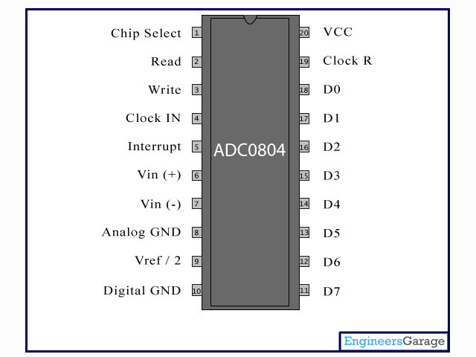
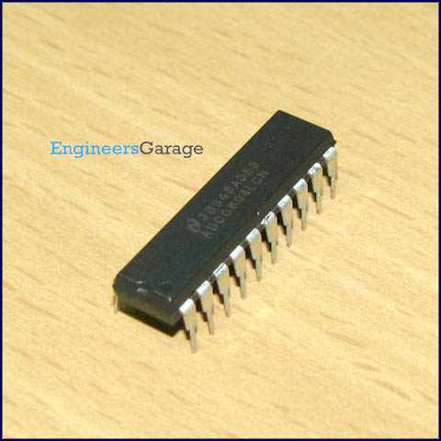
ADC0804

Slide 5
LM35 temp./vol. list
0V -> 0°C 10mV -> 1°C 20mV -> 2°C 1V -> 100°C
Temp °C = 100 * voltage

Slide 6

ADC0804
The ADC080X family are CMOS 8-Bit, successive-approximation A/D converter.
The voltage reference input can be adjusted to allow encoding any smaller analog voltage span to the full 8 bits of resolution.
（互補式金屬氧化物半導體；Complementary Metal-Oxide-Semiconductor，CMOS）

Slide 7
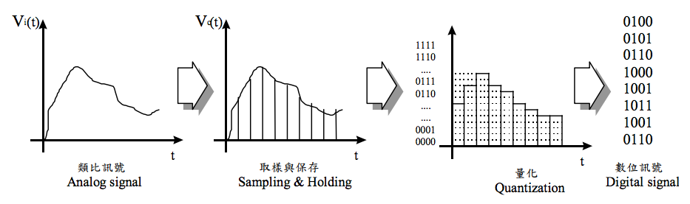
Analog converts to digital signal
Notes:
類比訊號為連續性
取樣率：每n秒
量化：犧牲精準度，取決於ADC的解析度8bit, 16bit

Slide 8
Analog voltage converts to digital voltage
ADC0804 is 8-Bit A/D converter
Level is from 00H to FFH (0~255, 256 levels)
Each level voltage＝(ref. voltage*2)／256
The relation of analog voltage and digital one is:
Digital converted values (DB0~DB7)=$\frac{analog voltage ∗256}{ref. voltage∗2}$
Notes:
量測範圍 0-5 V
輸出數值 0-255

Slide 9
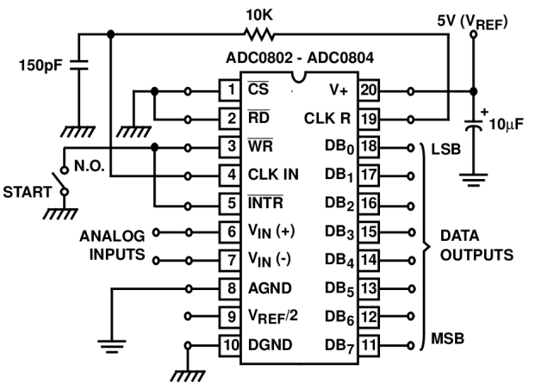
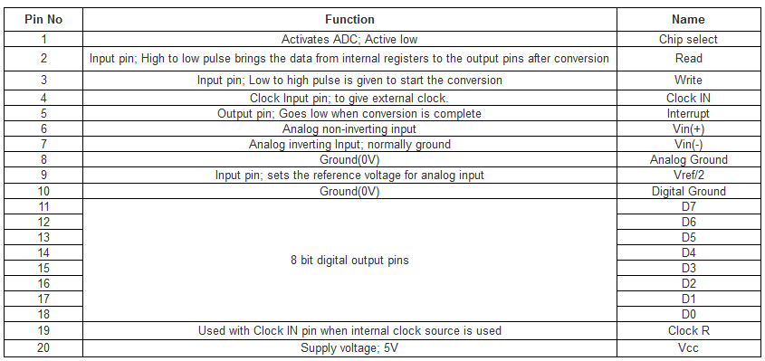
ADC0804
Pin description

Slide 10

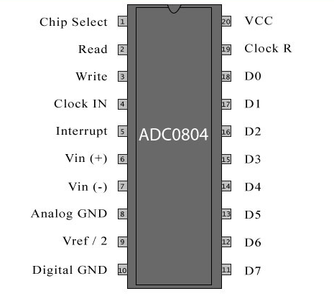
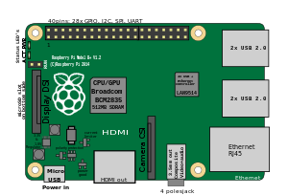
Analog to digital
High
1 0 0 0 1 0 0 0
Low
?? V
Low
Low
High
Low
Low
Low
If 0b00010001 = 17, the input voltage is?
Notes:
High -> 1 Low -> 0

Slide 11
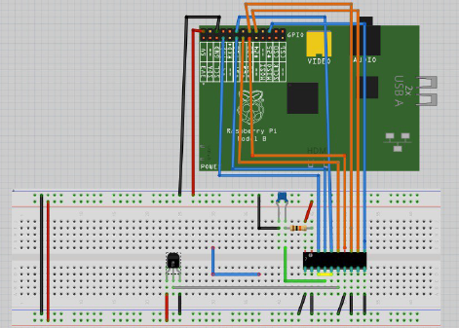
Connecting to RPi

Slide 12
Equipment
1*raspberry pi
1*10k resistor
1*ADC0804
1*150pf capacitor
1*LM35

Slide 13
Sample code
Import time, RPi.GPIO as GPIO
#define GPIO pins as input
GPIO.setup(7, GPIO.IN)
GPIO.setup(11, GPIO.IN)
GPIO.setup(12, GPIO.IN)
GPIO.setup(13, GPIO.IN)
GPIO.setup(15, GPIO.IN)
GPIO.setup(16, GPIO.IN)
GPIO.setup(18, GPIO.IN)
GPIO.setup(22, GPIO.IN)

Slide 14
Sample code
def get_temp(): d0 = GPIO.input(PIN7) d1 = GPIO.input(PIN11) d2 = GPIO.input(PIN12) d3 = GPIO.input(PIN13) d4 = GPIO.input(PIN15) d5 = GPIO.input(PIN16) d6 = GPIO.input(PIN18) d7 = GPIO.input(PIN22) value = (d7 << 7) + (d6 << 6) + (d5 << 5) + (d4 << 4) + (d3 << 3) + (d2 << 2) + (d1 << 1) + d0 voltage = convert ADC values into voltage temp = convert voltage into temperature print "0b%d%d%d%d%d%d%d%d, value=%d, voltage=%f, temp=%f" % \ (d7, d6, d5, d4, d3, d2, d1, d0, value, voltage, temp) return temp

Slide 15
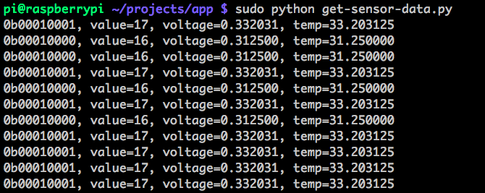
Result
$sudo python temperature.py

Slide 16
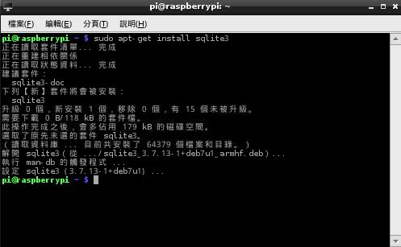
SQLite database access
It is a free software and provides to serverless mode for data access.
Install commend:
$ sudo apt-get install sqlite3

Slide 17



SQLite database access
Create your file database:
$ sqlite3 [database name].db
Create a table (an example)
$ CREATE TABLE fruit ( name TEXT, calories INT, price NUMERIC)

Slide 18
SQLite database access
Commends (examples):
(query) $ SELECT * FROM fruit
(query) $ SELECT * FROM fruit WHERE name = "Raspberry“
(query) $ SELECT * FROM fruit WHERE price > 0.8
(delete) $ DELETE FROM fruit WHERE name = "Raspberry“
(exit) $ .exit
(list) $ ls

Slide 19
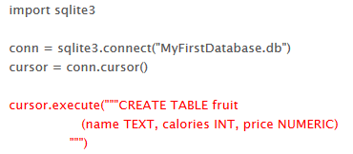
Implementation using Python
Create a database

Slide 20
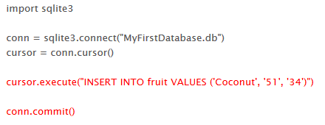
Implementation using Python
Create contents of the database

Slide 21
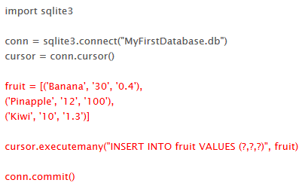
Implementation using Python
Create a set of data

Slide 22
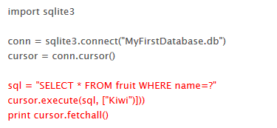
Implementation using Python
Query the database

Slide 23
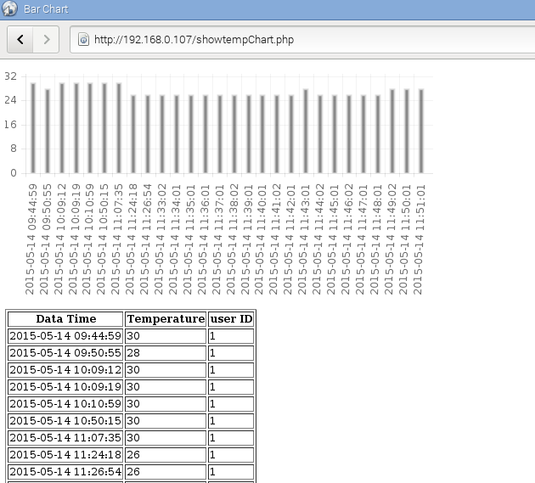
Lab 3: Temperature Monitor
Show the variation of temperature on PHP web page.

Slide 24
Install MySQL GUI Management (optinal)
MySQL workbench:
http://dev.mysql.com/downloads/workbench/)

Slide 25
Write to database(一)
Under command line mode:
pi@raspberrypi:mysql –uroot –p
(type your pasword)
Creat your database and build a temperature table:
mysql> CREATE DATABAE [myDatabaseName];
mysql> USE [myDatabaseName];
mysql> CREATE TABLE temp (datetime DATATIME NOT NULL,temp FLOAT NOT NULL,userid INT NOT NULL);

Slide 26
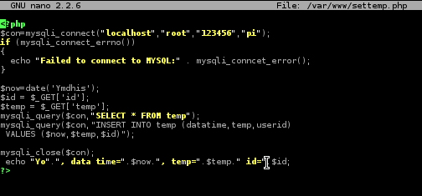
Write to database(二)
Use a PHP script to write temperature data in to ‘temp’ table:
$Sudo nano /var/www/settemp.php
Root: account
123456: password
Pi: database name

Slide 27
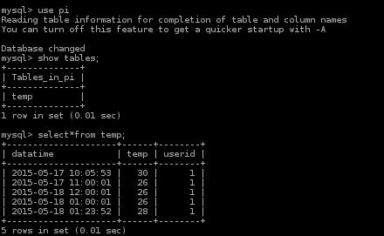
Write to database(三)
Test your do:
http://192.168.XXX.XXX/settemp.php?id=1&temp=30
Show in the terminal:
Mysql>use pi (into database)
Mysql>show tables; (show all tables)
Mysql>select*from temp; (show selected table)

Slide 28
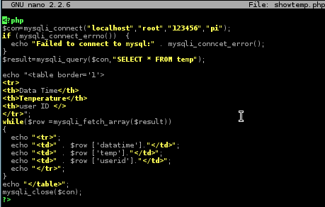
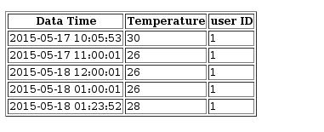
Show your result in the web page
The PHP script is shown below:
$Sudo su
#cd /var/www
#nano showtemp.php

Slide 29
Challenge
How to dynamically monitor the variation of temperature is a challenge.

